Slide 1

SDK Overview
Rob DeCarlo
Bechtel

Slide 2

Packages
iRING Tools Adapter
iRING Tools Sandbox
Interface Service
Sandbox Service
Adapter Service
Reference Data Service
Mapping Editor
Reference Data Editor

Slide 3
Adapter Dependencies
iRING Tools Adapter
Interface Service
Adapter Service
iRING Tools Sandbox
Mapping Editor
Reference Data Service

Slide 4
SPARQL Protocol
SPARQL Protocol
SPARQL Query
SPARQL Client
SPARQL Endpoint
SPARQL Results

Slide 5
SPARQL Data Exchange
SPARQL Protocol
SPARQL Client
Interface Service
(SPARQL Endpoint)
SPARQL Query Only
SPARQL Endpoint
Adapter
Service
(SPARQL Client)
SPARQL Endpoint
SPARQL Endpoints
SPARQL Query Only
SPARQL Protocol

Slide 6
Adapter Overview
SPARQL Client
Interface Service
SPARQL Endpoint
Adapter Service
Legacy Database
SPARQL Endpoint
SPARQL Endpoints
Mapping Editor
SPARQL Protocol

Slide 7
Sandbox Overview
Reference Data Editor
SPARQL Protocol
QMXF
Search Results
RDS/WIP
Reference Data Service
SPARQL Query Only
SPARQL Query and Update
Sandbox

Slide 8
XML Data Exchange
Adapter
Service
Data Transfer Object
Adapter
Service

Slide 9
Data Services
BizTalk
Data Transfer Object
Adapter
Service
Ajax
Client
SSRS

Slide 10

Mapping Editor
Mapping Editor
Dictionary
Mapping
Adapter Service
Search Results
QMXF
Sandbox

Slide 11
Adapter Framework
Triple
Stores
SPARQL Query & Update
SemWeb API
[extensible]
…
Data Stores
& APIs
Semantic Repository
Part 9
XML
Representations
NHibernate
RDF
Part 8
ECSchema
QXF
Data Source
Projection
DTO
Part 7
EFSchema
QTXF
Excel
MIMOSA
[extensible]
…
[extensible]
…
Mapping

Slide 12
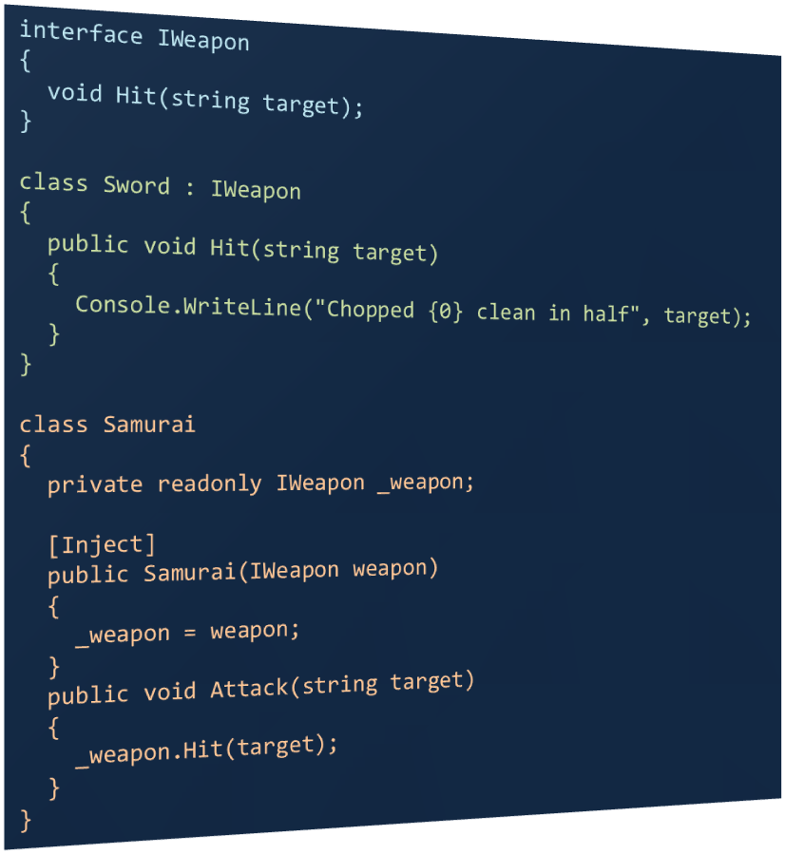

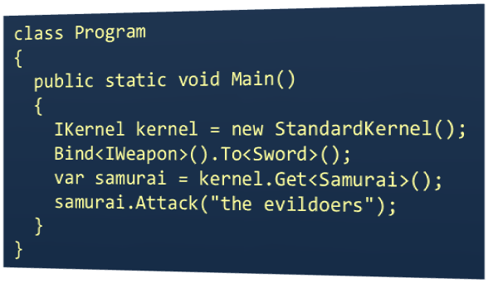
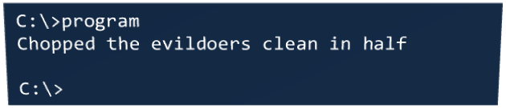
Dependency Injection

Slide 13
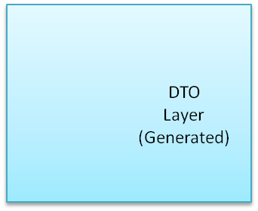
Adapter Interfaces
Adapter Service
Adapter Provider
Semantic Layer
ISemanticLayer
Projection Layer
Data
Layer
IProjectionLayer
IAdapterService
IDataLayer

Slide 14
Data Layer Extensibility
Implementers should provide generic access to classes representing legacy application data, and provide a dictionary describing them.
DTO Layer (Generated)
IDataLayer
Custom
Data Layer
T Get<T>(Dictionary<string, object> queryProperties);
IList<T> GetList<T>(Dictionary<string, object> queryProperties);
IList<T> GetList<T>();
Response Post<T>(T dataObject);
Response PostList<T>(List<T> dataObjects);
DataDictionary GetDictionary();
Data API
Response
(List<string>)
Your Types (T)
Data
Dictionary
Binding Configuration
IDataLayer
Binding Configuration tells NInject where to find your classes.

Slide 15
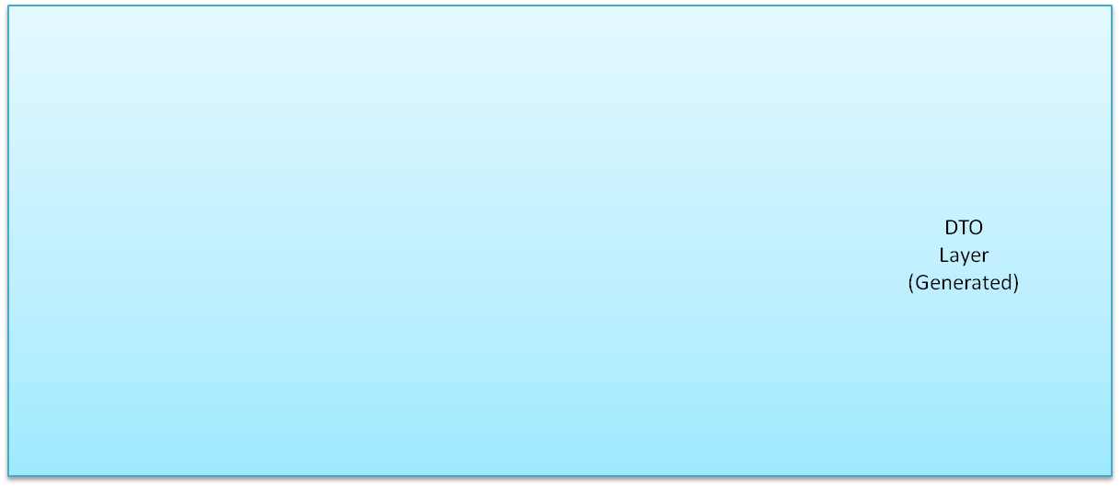
CSV Data Layer
Adapter Service
Adapter Provider
CSVDataLayer
CSV
Entity
Objects
Post
Entity
Objects
Entity
Objects
Get
Linq To XML
DOM
CSV Line

